Slide 1
L1 & L2 Regularization
COMP 3800
Professor: Armen Pischdotchian
Student: Son Nguyen

Slide 2
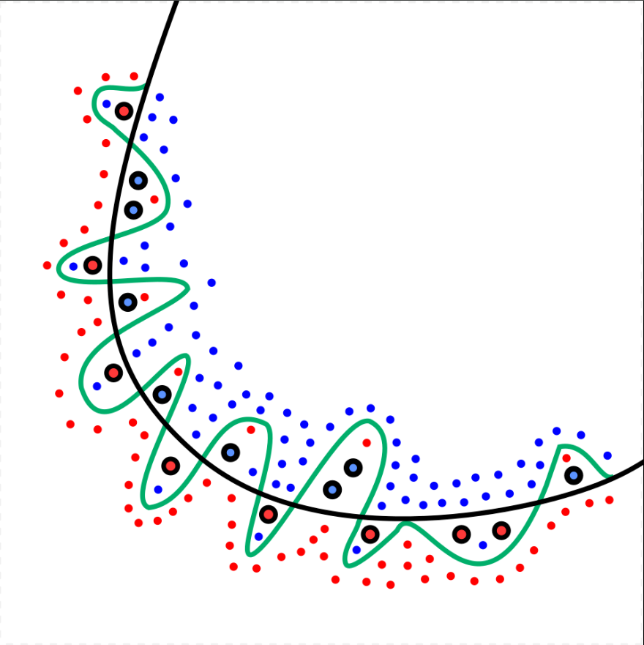
What is Overfitting
Overfitting is when a model learns the training data too well — including its noise and errors — making it perform poorly on new unseen data.
Example: A student who memorizes every practice test answer but fails the real exam because the questions are slightly different.

Slide 3
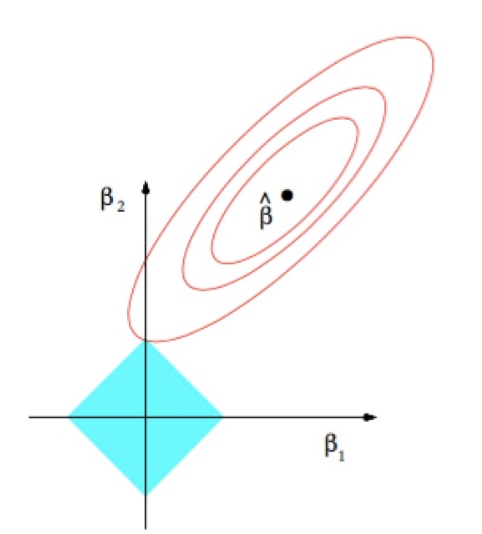

L1 Regularization (Lasso)
Formular
It penalizes large weights w by adding the term λ|w| to the objective function, where λ is the regularization strength that controls how much penalty is applied to large weights.

Slide 4
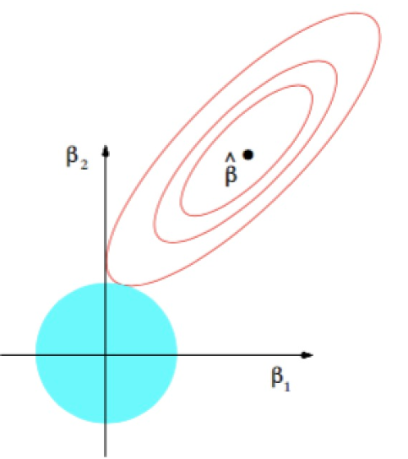

L2 Regularization (Ridge)
Formula
L2 regularization is perhaps the most common form of regularization, analogous to the penalty term in Ridge regression. It penalizes the squared magnitude of the weights w by adding the term ½λ∑w² to the objective function that the algorithm is trying to optimize, where λ is the regularization strength, also called the shrinkage parameter, which can be tuned during training.

Slide 5
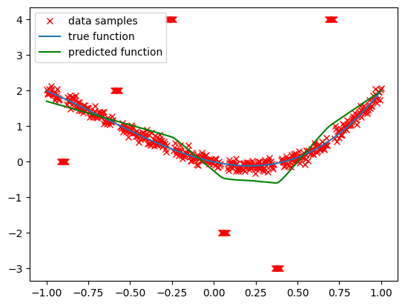
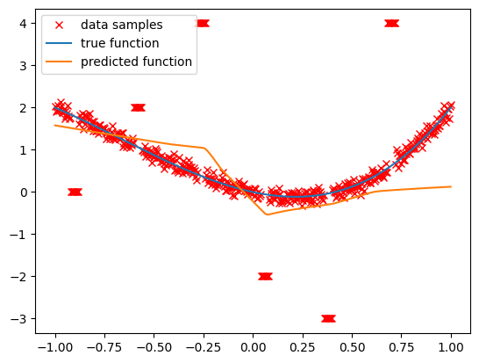
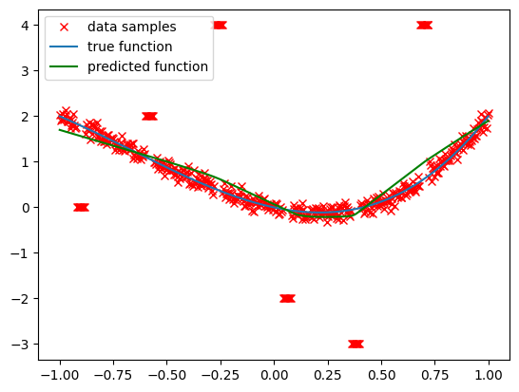
Final Result
Normal Data
Ridge
Lasso
MSE: 1.9096
MSE: 1.6803
MSE: 1.8229

Slide 6
Thank you for your attention!
Any question ?

